Slide 1
Power in the ancient world
Year 11 Ancient History
Unit 1, Week 1: Lesson 1

Slide 2

Use connect
The following will be found on our Connect Page:
Unit 2 Program
Course content - uploaded each week
Extra Resources/revision material No surprises!

Slide 3
Unit 2 Program
Ensure you keep this!

Slide 4
Unit 2: power in the ancient world
Alexander the Great, Macedonia, 356 - 323BCE Julius Caesar, Rome, 100-44BCE
In this unit, students learn that, in ancient societies, key individuals have acted as agents of change, interacting with groups and institutions, and using their power to shape their society.
They investigate key individuals’ motives, the methods they used to achieve power, the ways they used their power, the responses of others to their use of power, and their impact and influence on society.
Students also learn that individuals, groups, and institutions have a variety types of power, and that power is not distributed evenly throughout the society.

Slide 5
Week | Content | Assessment/s
1 | Macedonia Overview
2 - 5 | Alexander the Great | T6: Source Analysis
6 - 7 | Representations of ATG | T7: Test
8 | Rome Overview
9 - 12 | Julius Caesar | T8: Essay/Explanation
13 | Representations of Caesar | T9: Source Analysis
14 - 16 | Investigation | T10: Inquiry

Slide 6
This week
Lesson | Topic/Content
1 | Macedonia – Overview, Geography
2 | Macedonia – Key Structures
3 | Values, Beliefs & Timeline

Slide 7
ACTIVITY
https://www.youtube.com/watch?v=3cHA56C9EqY
Watch the following video

Slide 8
DIscussion
Macedonia –
People/events/ideas?

Slide 9
Key terms:
HELLENIC: of, relating to, or characteristic of the ancient Greeks (especially before the time of Alexander the Great).
HELLENISTIC: the period of Mediterranean history between the death of Alexander the Great in 323 BC and the emergence of the Roman Empire.
PHALANX: a body of troops or police officers standing or moving in close formation.
LEAGUE OF CORINTH: offensive and defensive alliance of all the Greek states (except Sparta, organized in 337 BCE at Corinth under the leadership of Philip 11 of Macedon.

Slide 10
Ancient macedonia
Small kingdom located in northern Greece. Mackednoi (Mahk-ed-noy) tribe first inhabited the area and gave the country its name.
According to the ancient historian, Herodotus, they were the first people to call themselves “hellenes.” The term Hellenistic later became synonymous with all things Greek.
However, the Mackednoi tribe had little to do with southern Greece for centuries.
Macedonian monarchy began in 808 B.C.E. with Caranus, who was the first known king of Macedonia.
359 B.C.E., when King Phillip II became the ruler, he united the southern Greek city-states with the north, and brought them all under Macedonian rule.
King Phillip II improved his army and began to devise plans to conquer other lands in the Mediterranean region.
He died before he was able to put his plans into action. His son Alexander, later known as Alexander the Great, was able to expand Macedonia.

Slide 11
geography
Colour the following onto your map and label

Slide 12
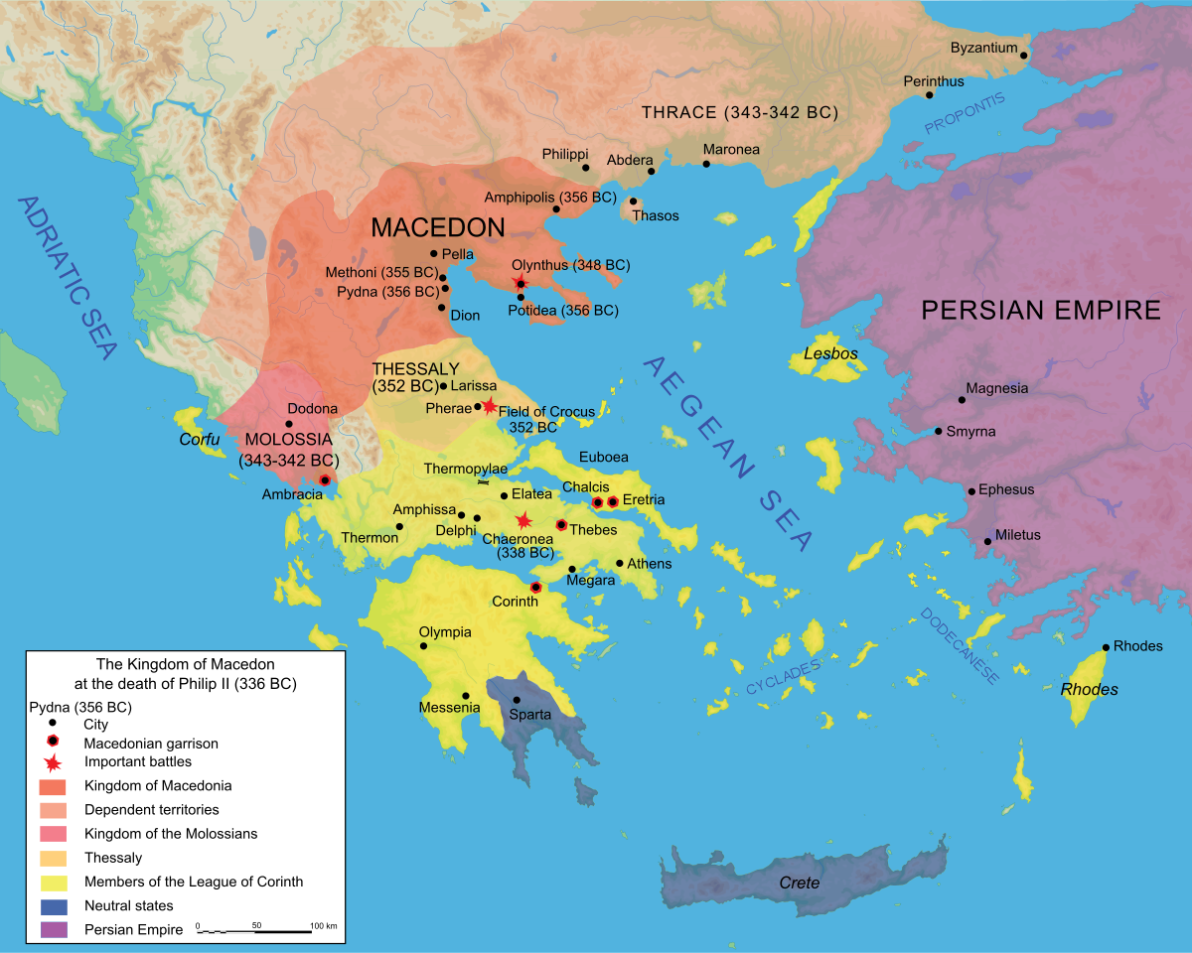

Slide 13
geography
Mountains divided the Greeks into independent city-states
Access to the sea allowed for trade and cultural diffusion (sharing of ideas)
Wealth and innovation made it a target for invasion

Slide 14
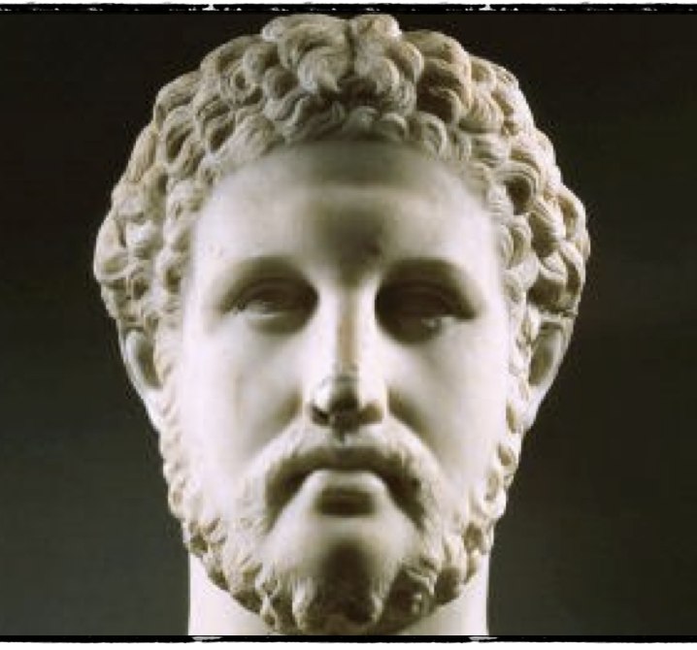
Who am i?
King Philip II of Macedon
382BC – 336BC

Slide 15
Phillip II of macedon Summarise the following on your worksheet
Phillip II created a federation of Greek states called the League of Corinth or Hellenic League to strengthen his military forces.
It was the first time in history that most of the Greek states had joined together as a single political entity.
Ancient Macedon was renowned for its military might.
Phillip II introduced a new kind of infantry known as the Macedonian phalanx, in which each soldier carried a long spear (called a sarissa) that was approximately 13 to 20 feet long.
The tight formation of the Macedonian phalanx formed a wall of spears, which was considered nearly impenetrable.
Phillip II dreamed of conquering the Persian Empire—the world’s largest at the time.
He was assassinated in 336 B.C., in Aigai, the capital city of Macedon, before he could realize his vision.
His son, Alexander the Great, one of history’s greatest military minds, came to power and finished the job his father had started.

Slide 16
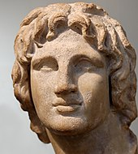
Who am i?
Alexander III of Macedon
356BCE – 323BCE

Slide 17
Alexander the great Summarise the following on your worksheet
Charismatic, ruthless, brilliant and bloodthirsty
13 reign as king of Macedonia changed the course of both European and Asian history.
Greek philosopher Aristotle tutored Alexander during Phillip II’s reign. Scholars have attributed Alexander’s diplomatic skills and habit of carrying books with him on his military campaigns to Aristotle’s influence.
Took the throne at age 20 after his father’s assassination. He quickly harnessed the military forces of the Hellenic League, assembling an army of more than 43,000 infantry and 5,500 cavalry.
In 334 B.C., he led the Macedonian army across the narrow straights of the Hellespont (today called the Dardanelles) into northwest Turkey. In one long military campaign that lasted 11 years, he conquered the Persian Empire making Macedonia the largest, most powerful empire in the world.
Alexander the Great’s Macedonian Empire spanned from Greece to India. He died of unknown causes in 323 B.C. in the ancient city of Babylon, in modern-day Iraq. He was just 32 years old.
Alexander the Great had no direct heirs, and the Macedonian Empire quickly crumbled after his death. Military generals divided up the Macedonian territory in a series of civil wars.

